Slide 1


Slide 2

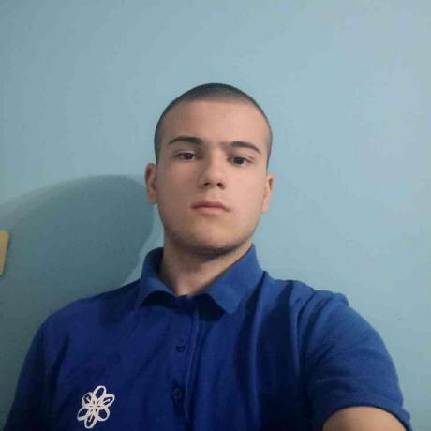
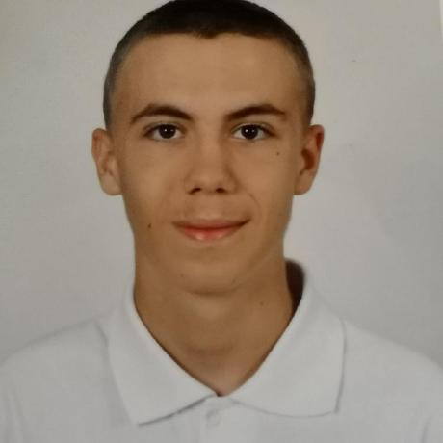
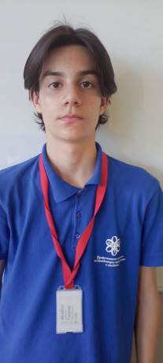
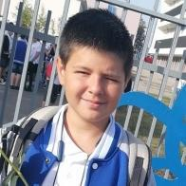
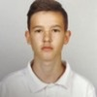
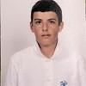
Team members
Nikolay Stoyanov
Miroslav Ivanov
Ivaylo Gyurov
Zlatin Lazarov
Ivelin Bozhilov
Scrum Trainer
Back-end Developer
Back-end Developer
Back-end Developer
QA Engineer
Kristian Dimitrov
Back-end Developer

Slide 3


OUR IDEA
No Name is a dynamic team that leverages coding to revolutionize the way students are tested across various subjects. This group of innovative developers seeks to create a fun, interactive and adaptive testing platform.

Slide 4
FORM THE TEAM
BRAINSTORM FOR IDEA
REPOSITORY ORGANISATION
ASIGN ROLES
Stages of realization
PRESENT
MAKE DOCUMENTS
START WORK ON THE PROJECT

Slide 5










Used technologies and languages

Slide 6
Now let's move to the Program!

